Slide 1


COVID Lens
Seth Goodwin | Tammy Ogunkale | Reagan Berhe | Mark He | Isaac Taylor

Slide 2
Background and Motivation
COVID-19 Virus → Global Pandemic
Safety and well-being of UNCG community
Avoid college shutdown
Reduce spread of virus
Encourage healthy habits (e.g., social distancing, wearing face masks)
Promote awareness

Slide 3
What is COVID Lens?

Slide 4
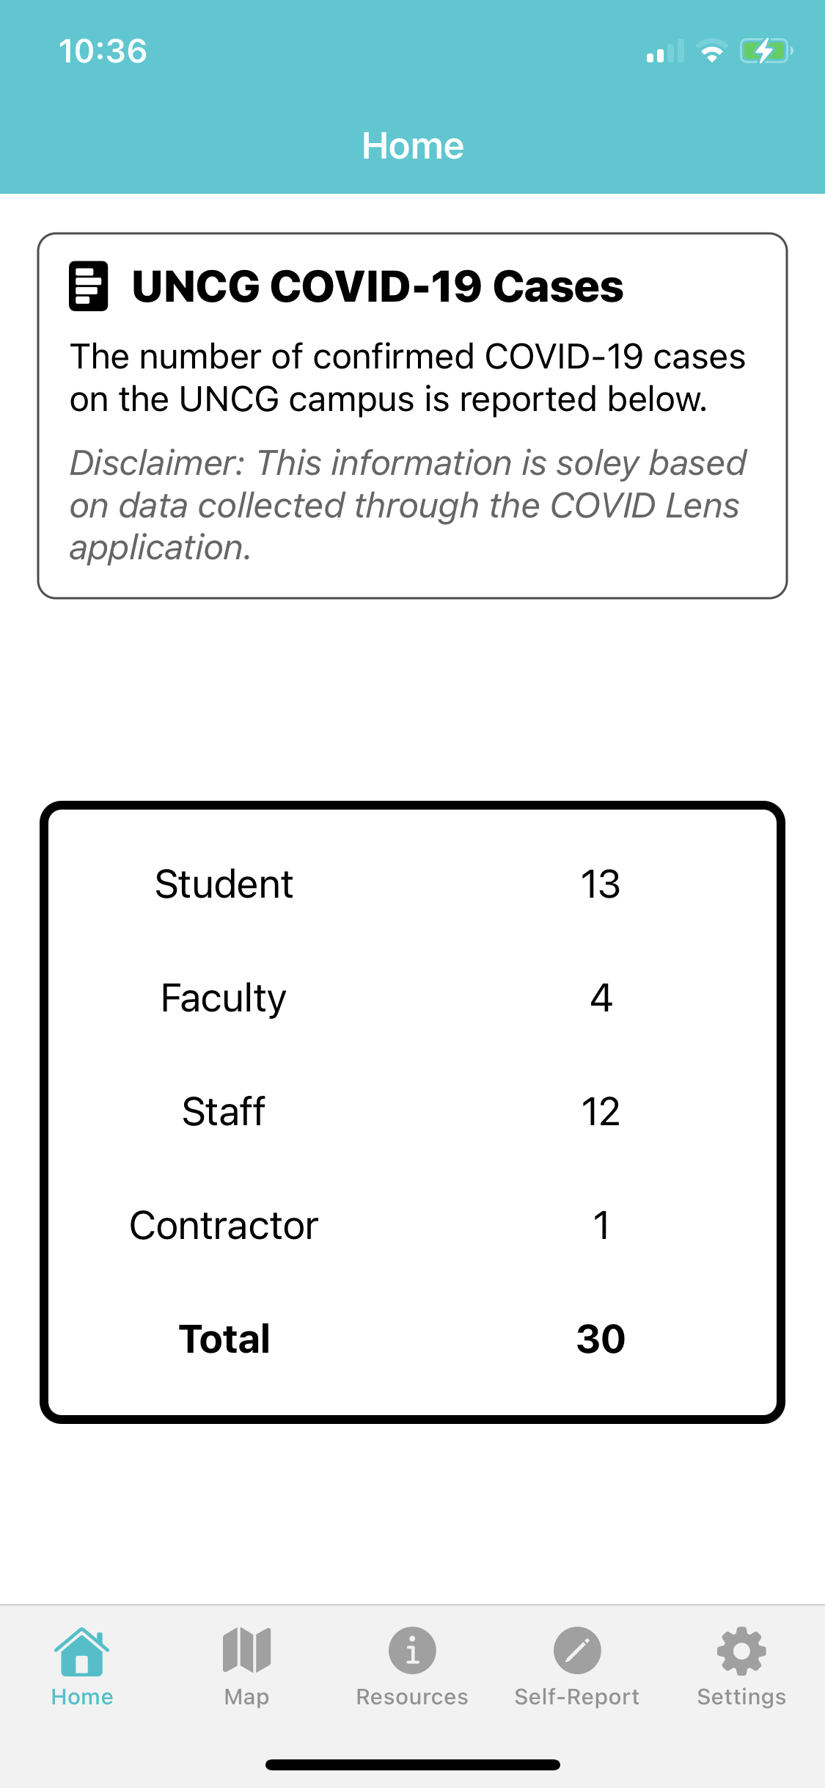
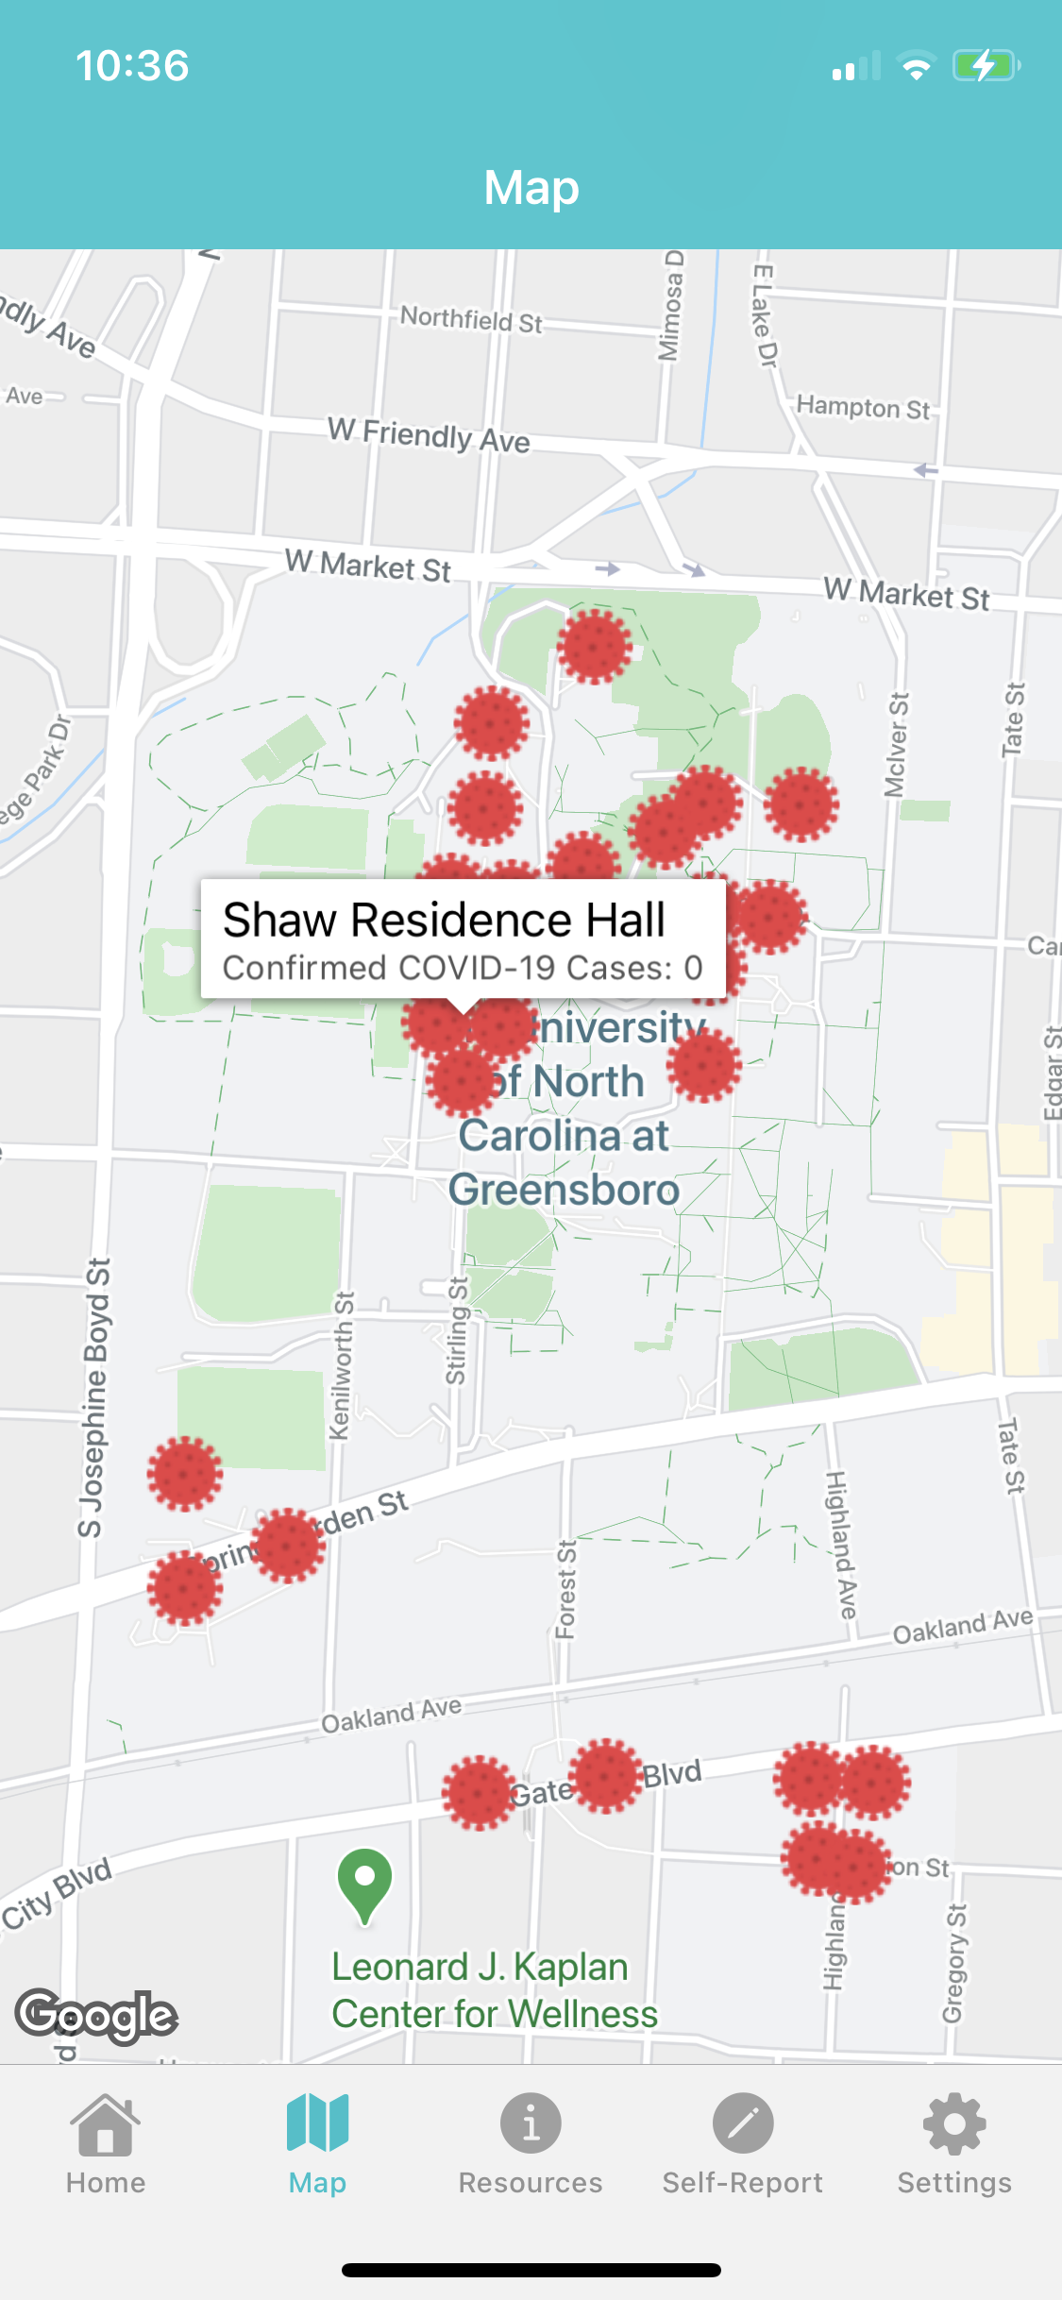
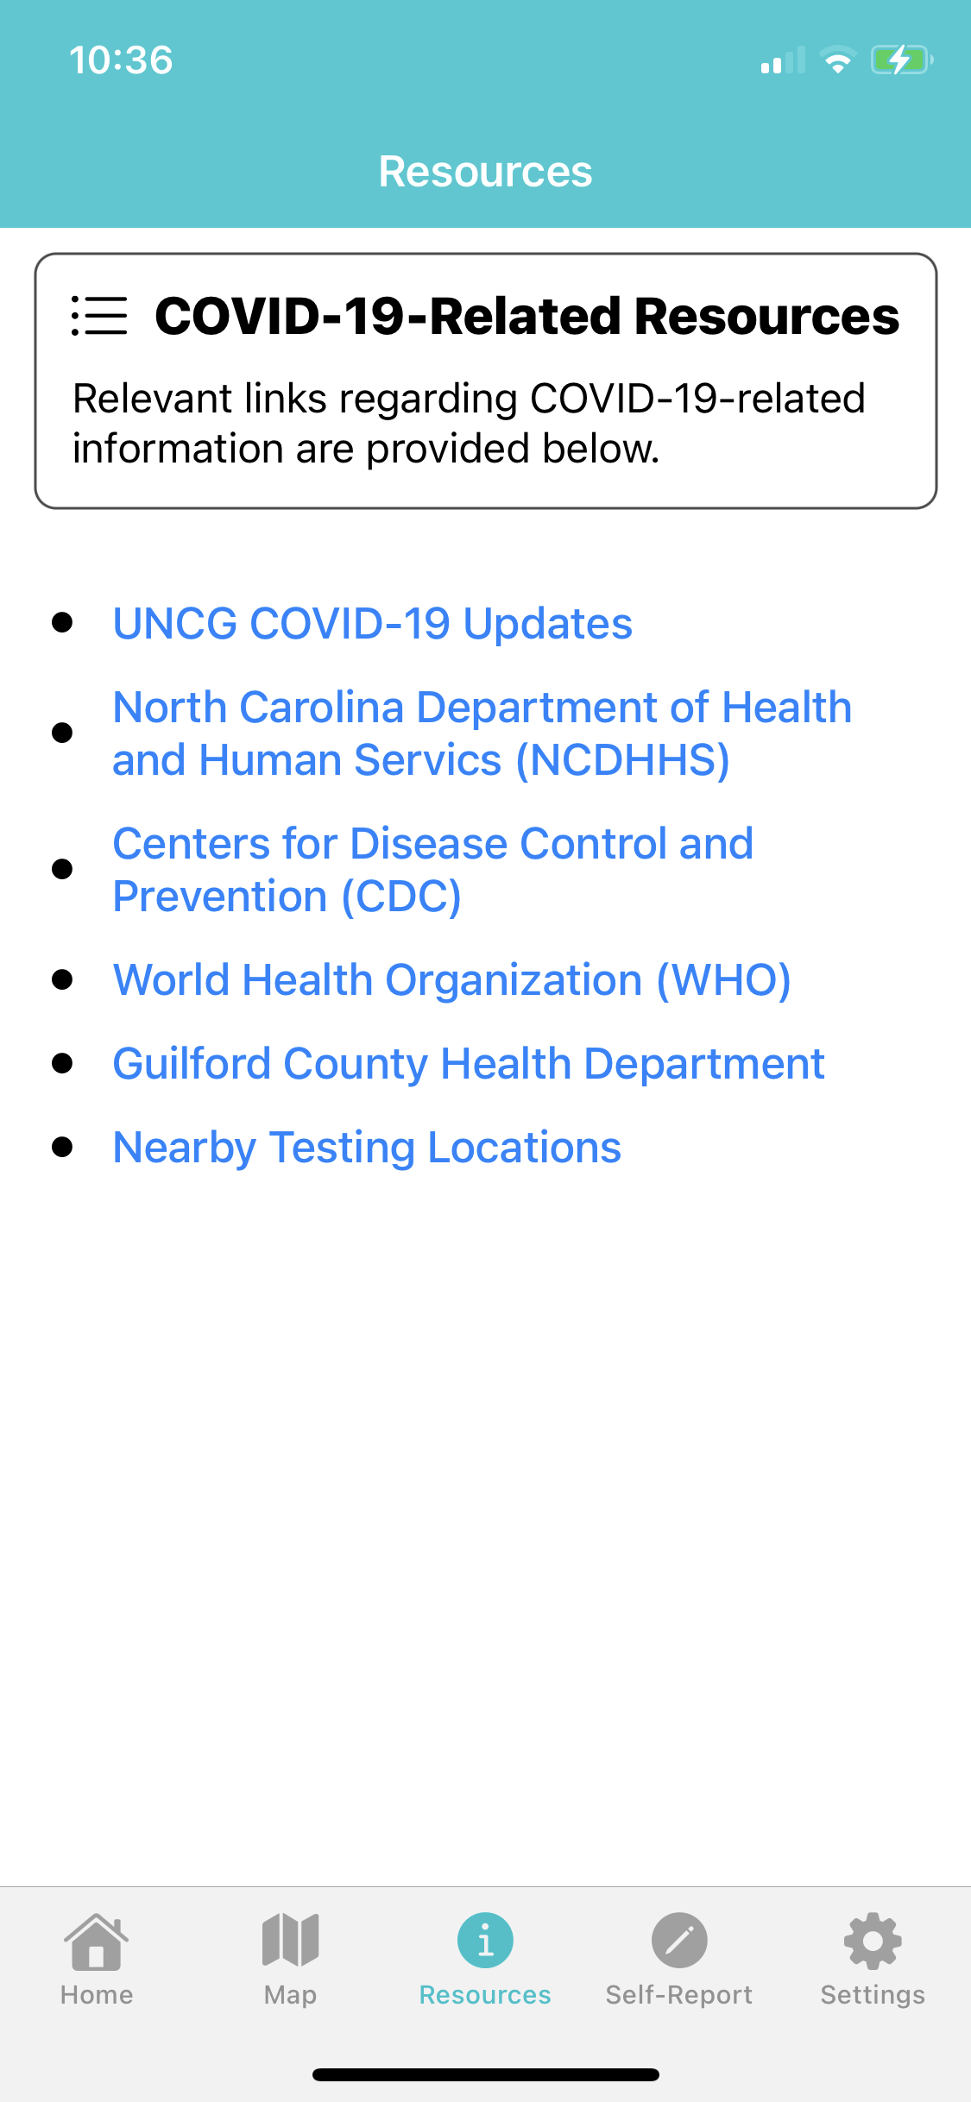
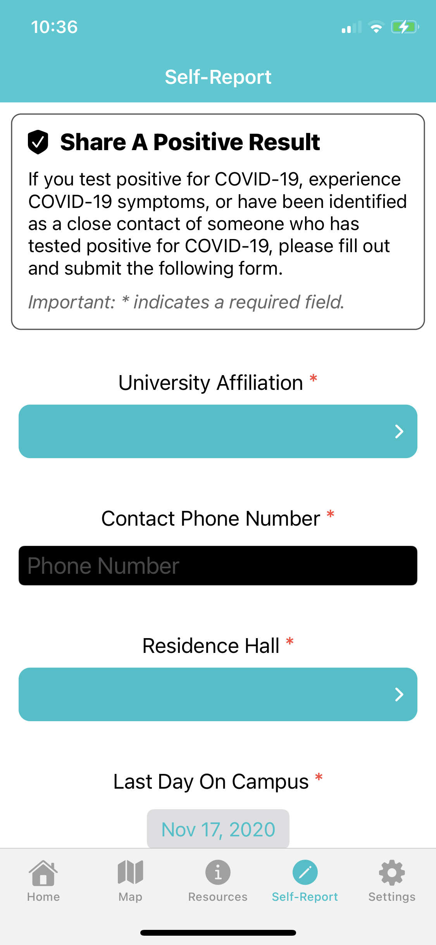
Home
Map
Resources
Self-Report

Slide 5
Demo

Slide 6
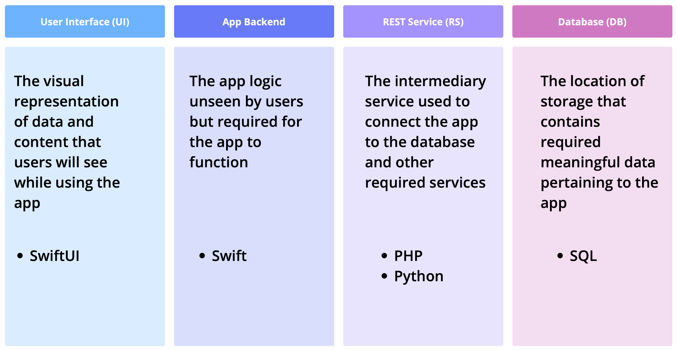
System Architecture

Slide 7
Questions?

